Slide 1
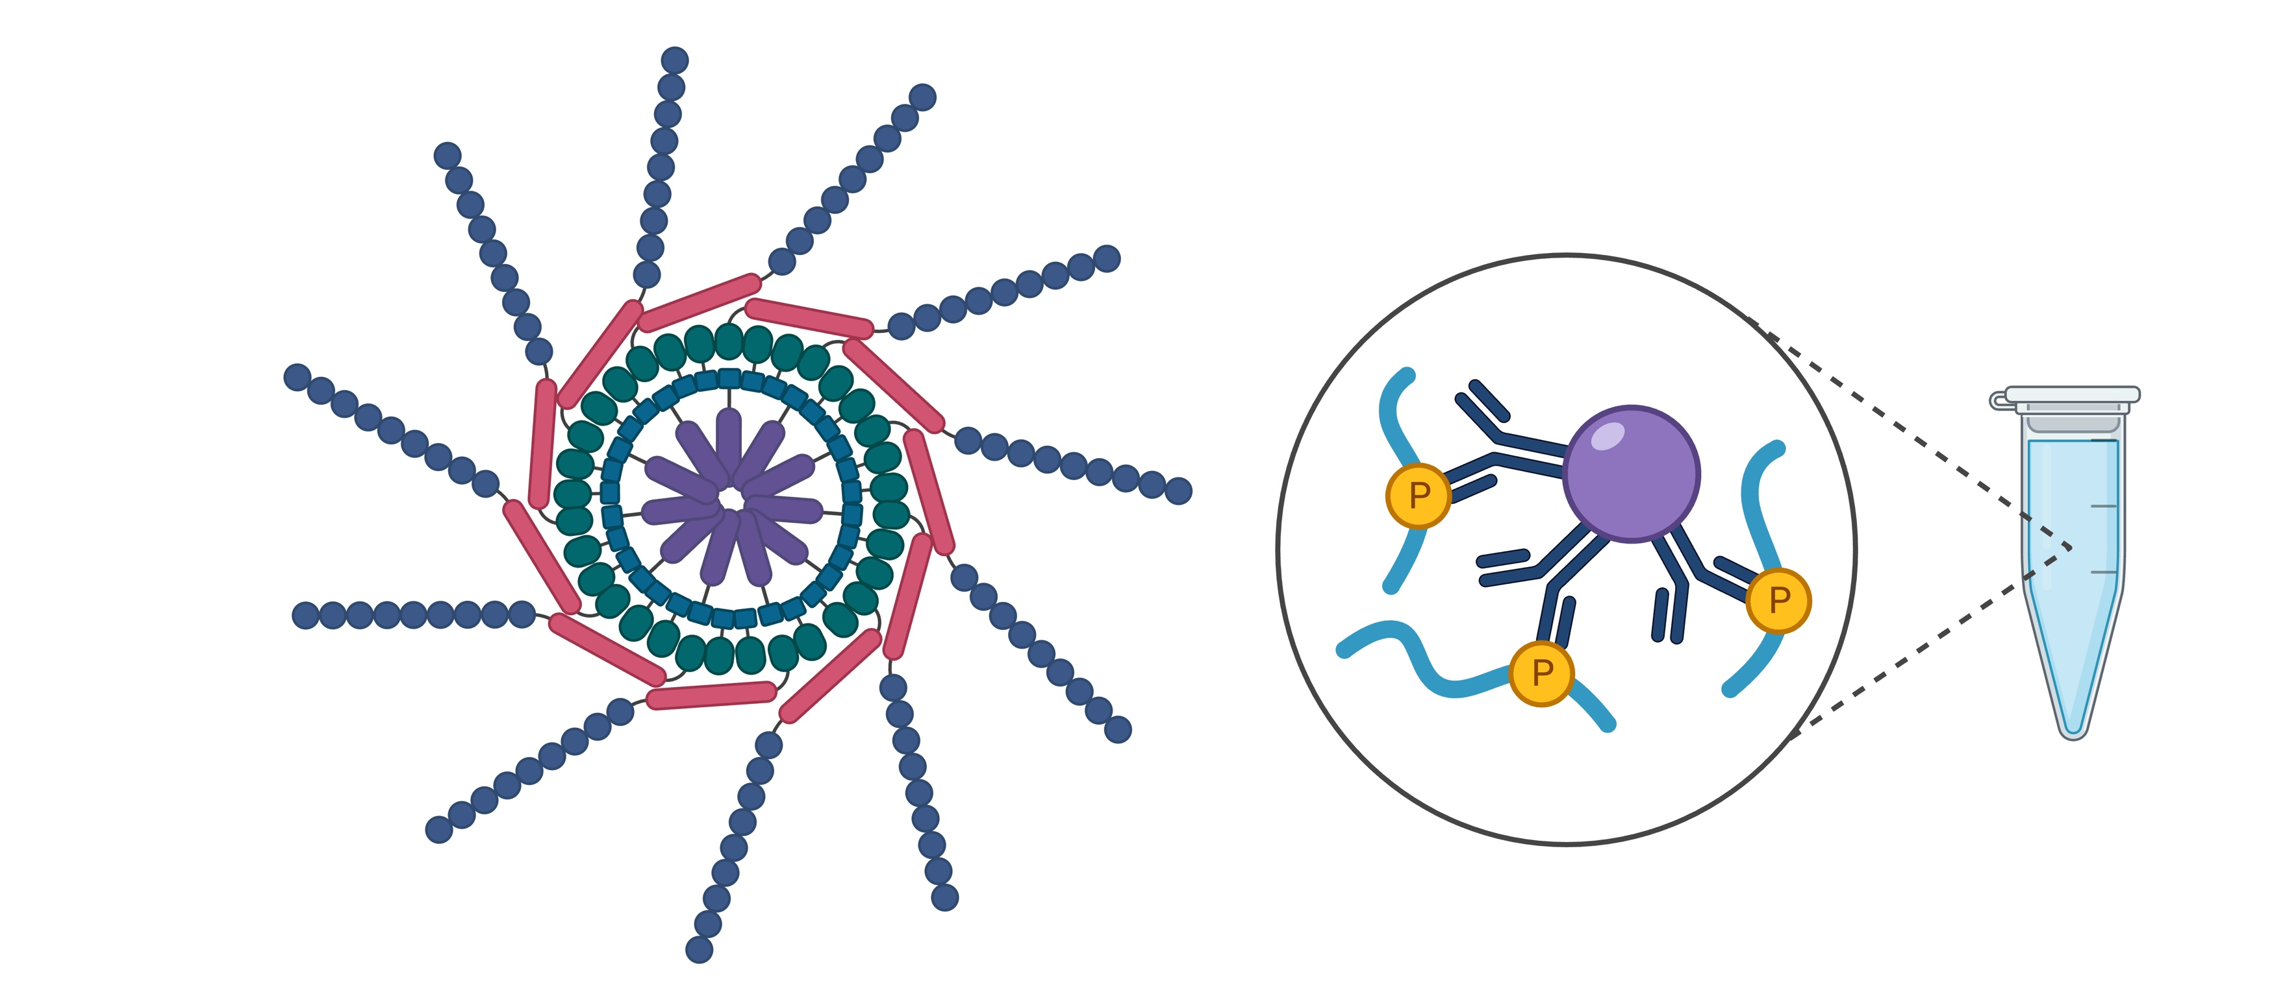

Analysis of Biomolecules from Protein Data Bank(PDB)
Presented by
Jennifer Noga Davinroy
Shruti Deshpande
Ali Parvez
Micah Lewis
Notes:
Move this first?

Slide 2
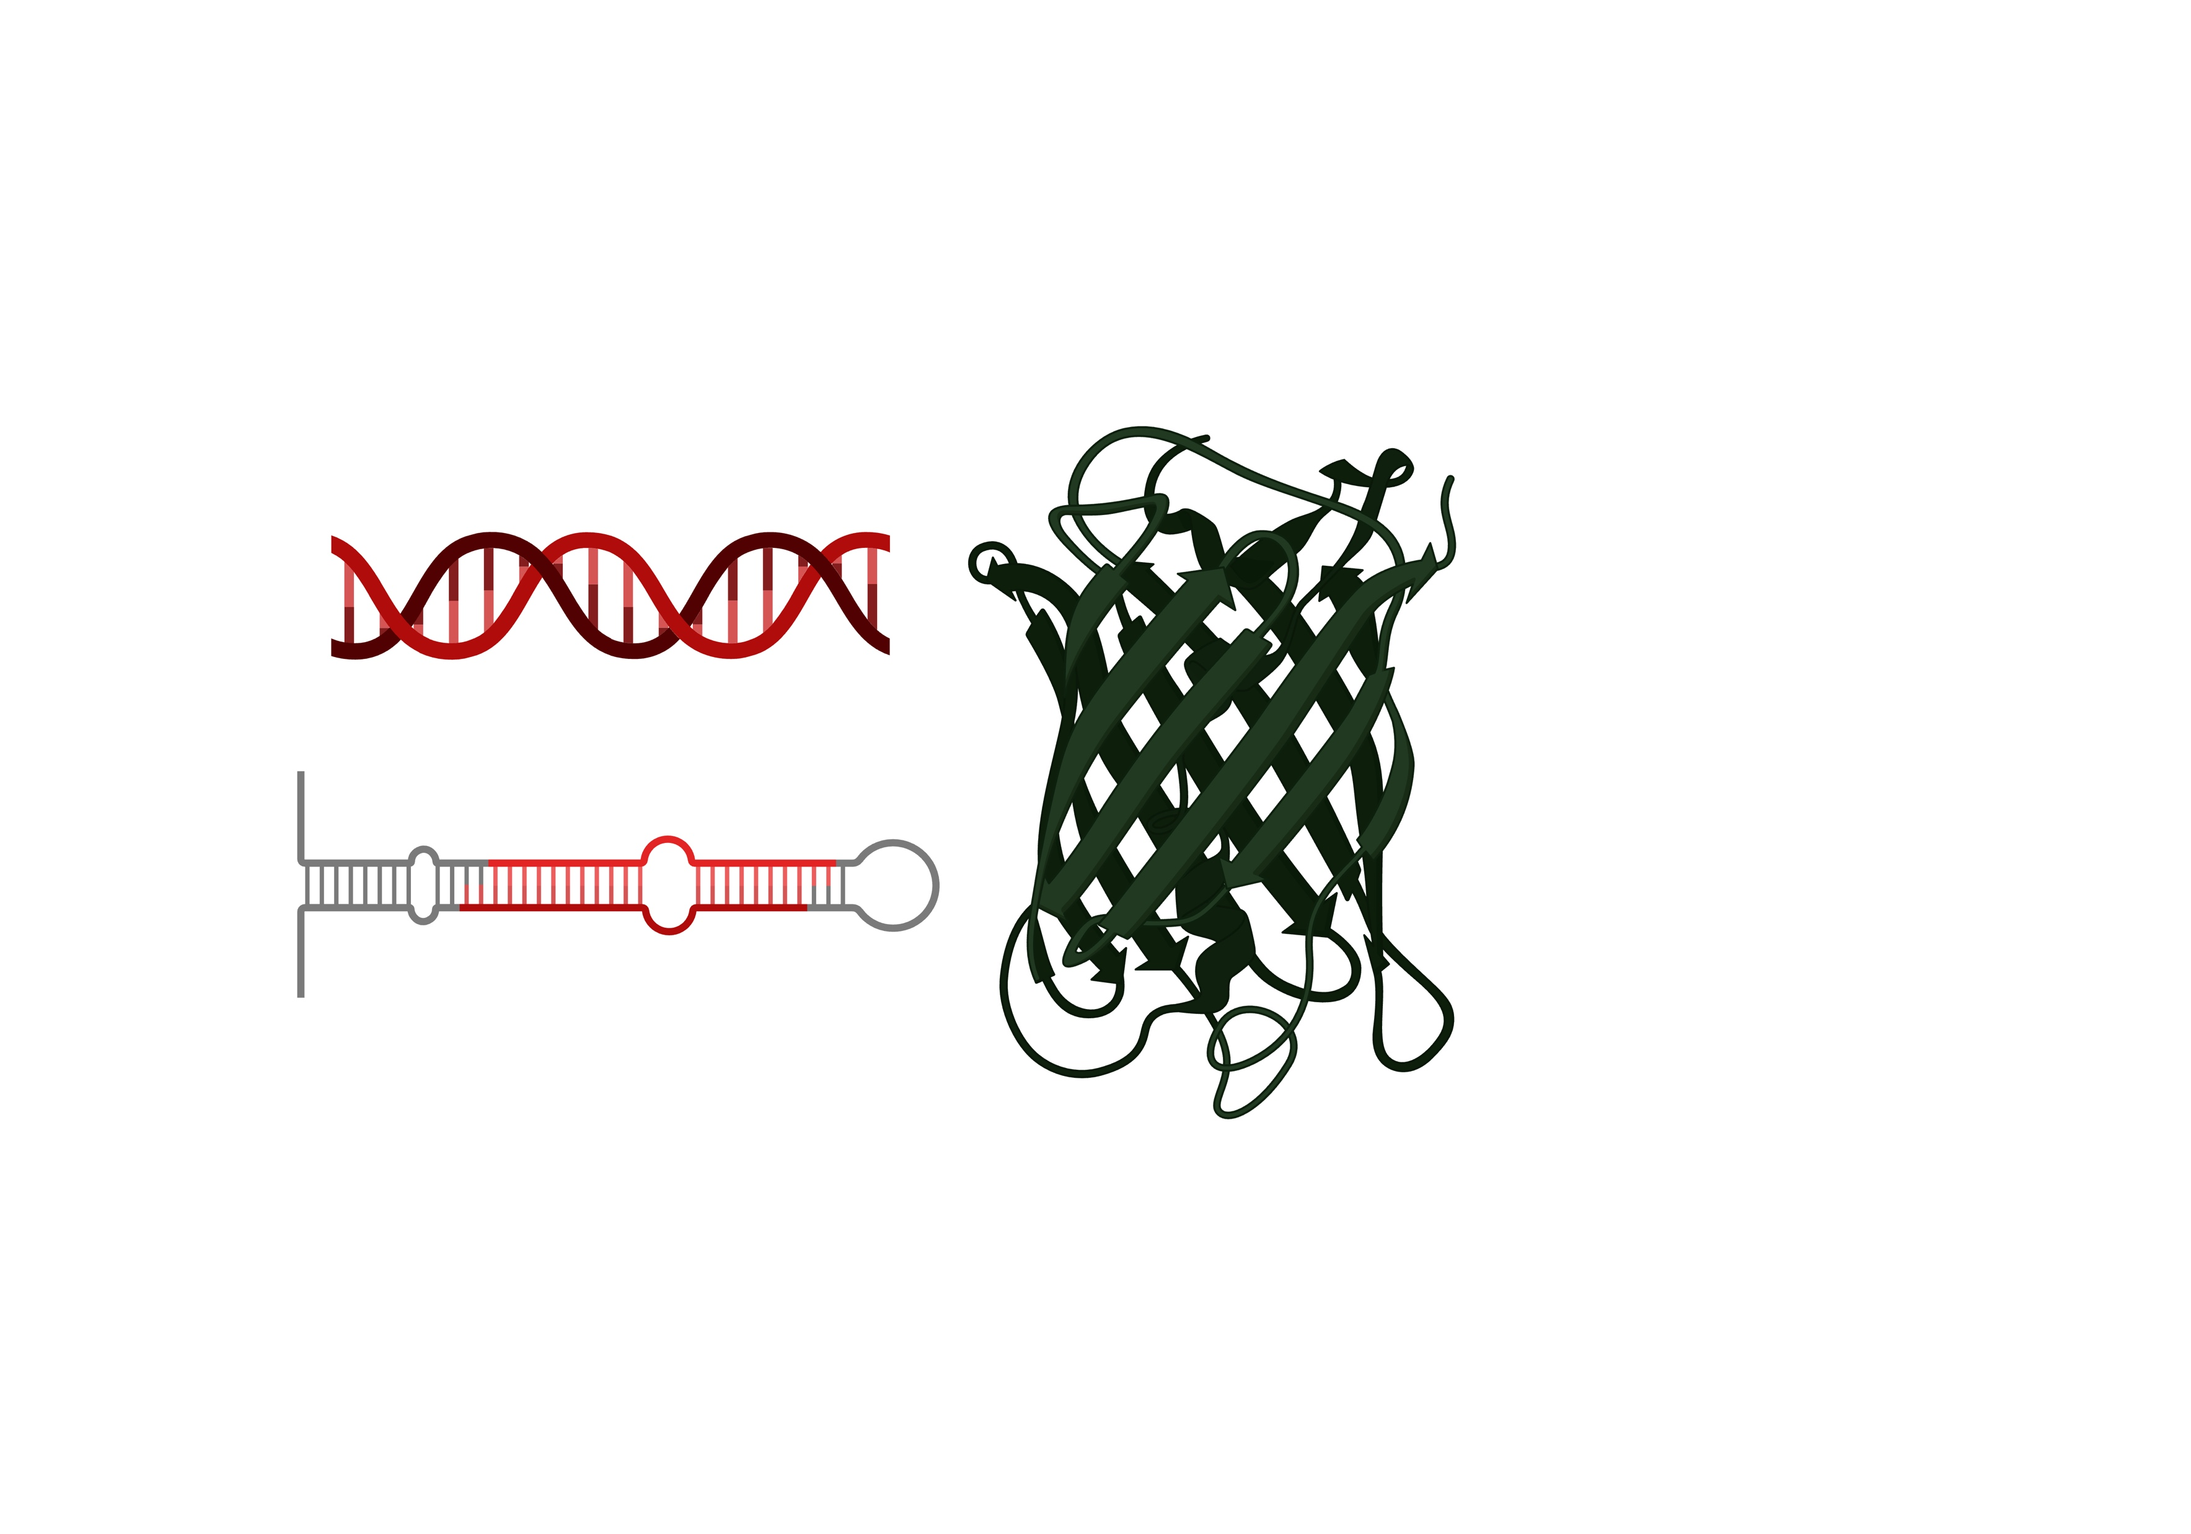
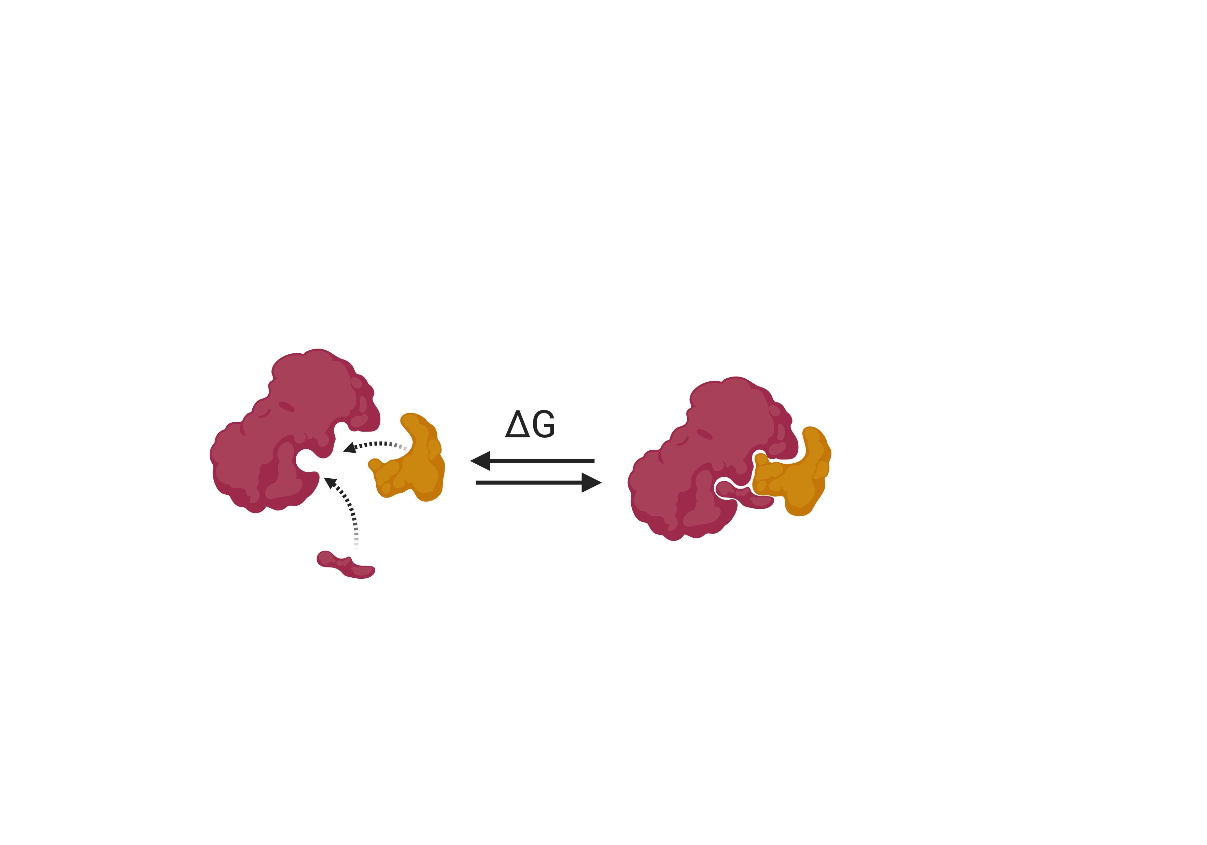
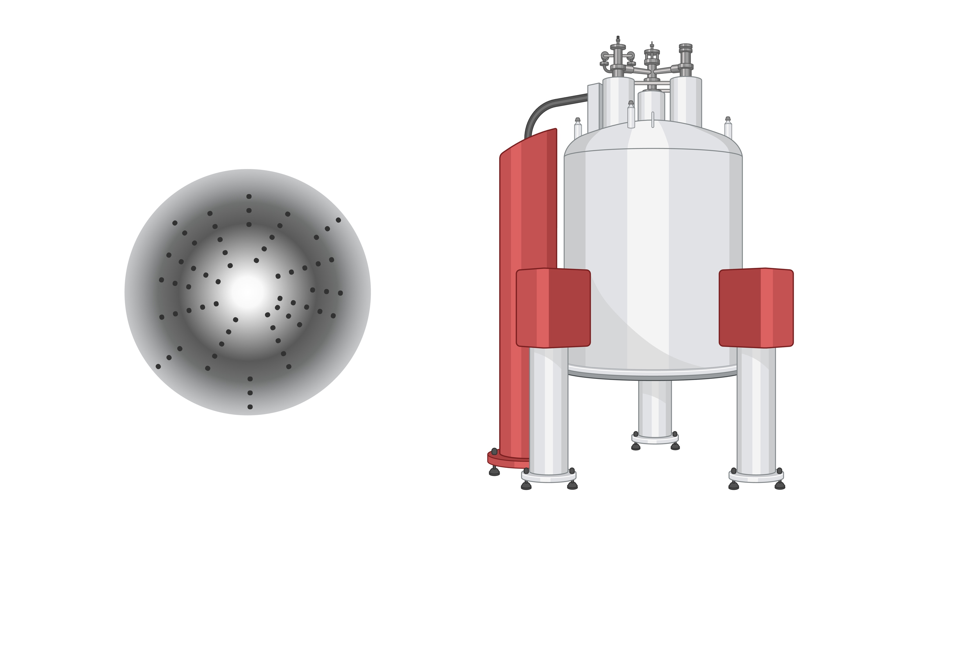
Introduction to PDB and Biomolecules
PDB is a database that contains data about a large number of biomolecules such as proteins, DNA, RNA, DNA-RNA hybrids, etc.
It is a comprehensive dataset which also contains structural information for the biomolecules
Key Terms for this project:
Ligand is something the biomolecule binds to.
K_{d} is the binding affinity of a biomolecule to a ligand. A lower number is better.
The structures of biomolecules are determined by 2 methods known as X-ray crystallography or NMR.
DNA and RNA oligonucleotides are referred to as sequences.
Molecular weight is a measure of the size of biomolecules.
Notes:
Move this first?

Slide 3
Scope of the Project
Part 1 of the presentation will discuss trends in discovering DNA and RNA sequences and the methods used to resolve their structural features.
Part 2 of the presentation will focus on the binding affinity trends of DNA and RNA oligonucleotides with various ligands.
Part 3 of the presentation will focus on the trends in binding affinity of proteins with various ligands.
Part 3 will also compare the binding affinity of proteins with DNA and RNA oligonucleotides for the same ligands to try and answer an important question for biologists: whether proteins are better binders for ligands or DNA and RNA.
Notes:
Move this first?

Slide 4
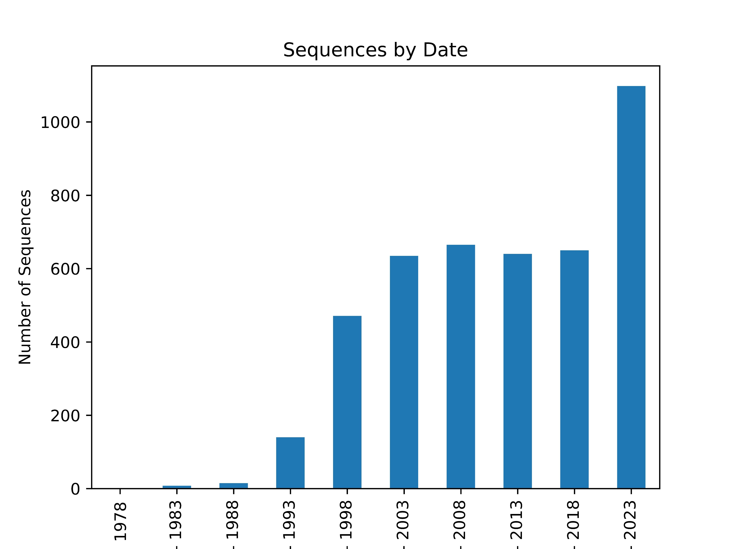
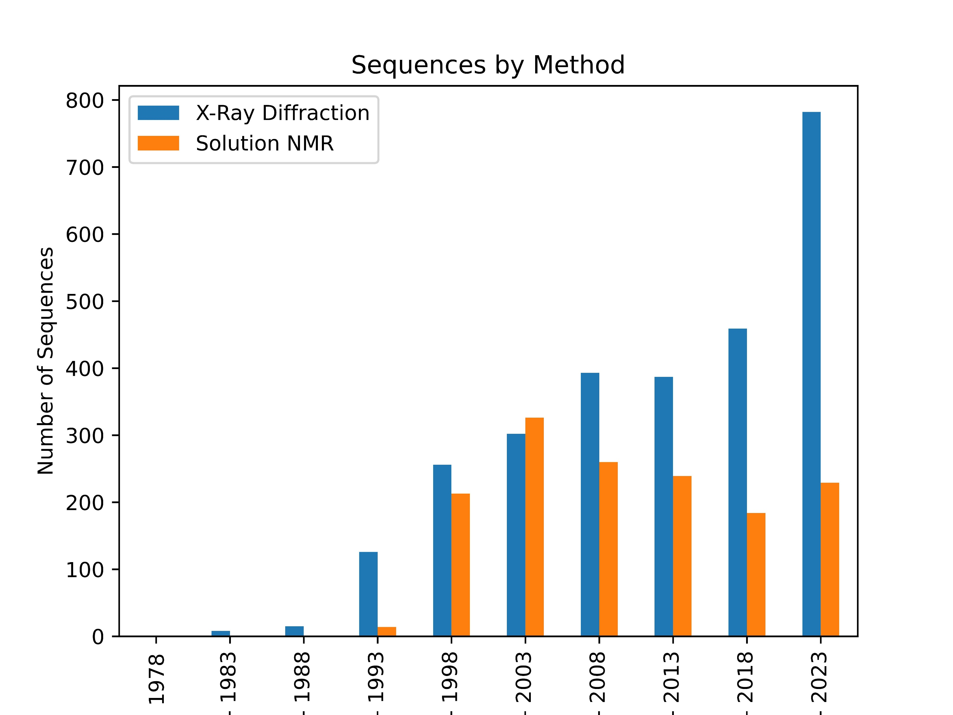
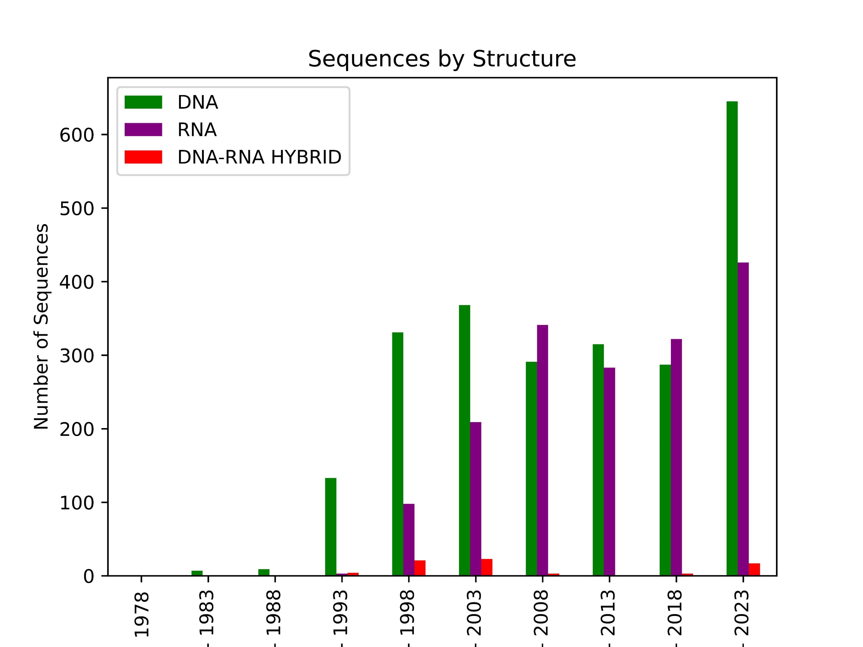
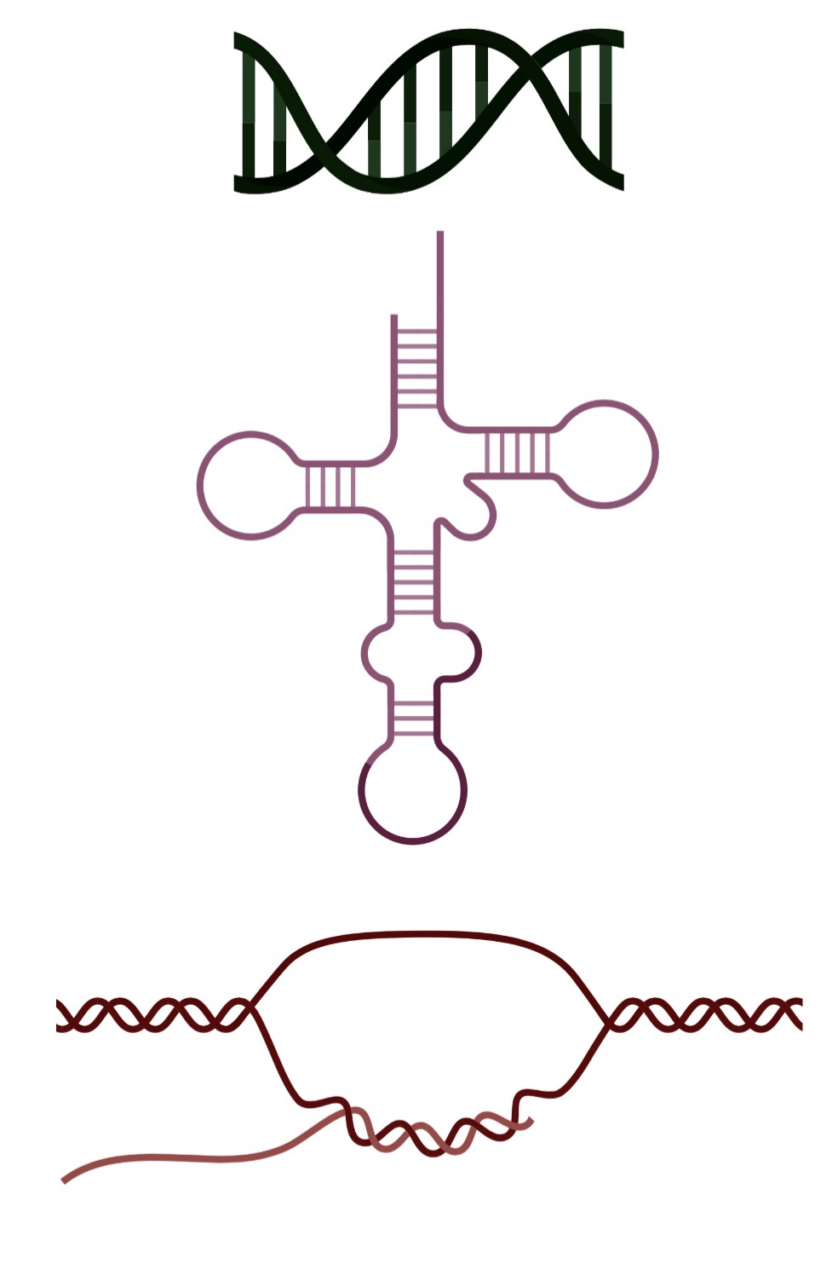
Part 1:Trends in the Discovery of DNA and RNA Sequences
DNA and RNA sequences show increased reporting and structure resolution over time.
Most of the sequences were resolved with X-ray diffraction over time but a fair number are also resolved with NMR spectroscopy. NMR is more advantageous as it provides dynamic structural information.
Most resolved sequences were DNA, followed by RNA and hybrids.
Notes:
Move this first?

Slide 5
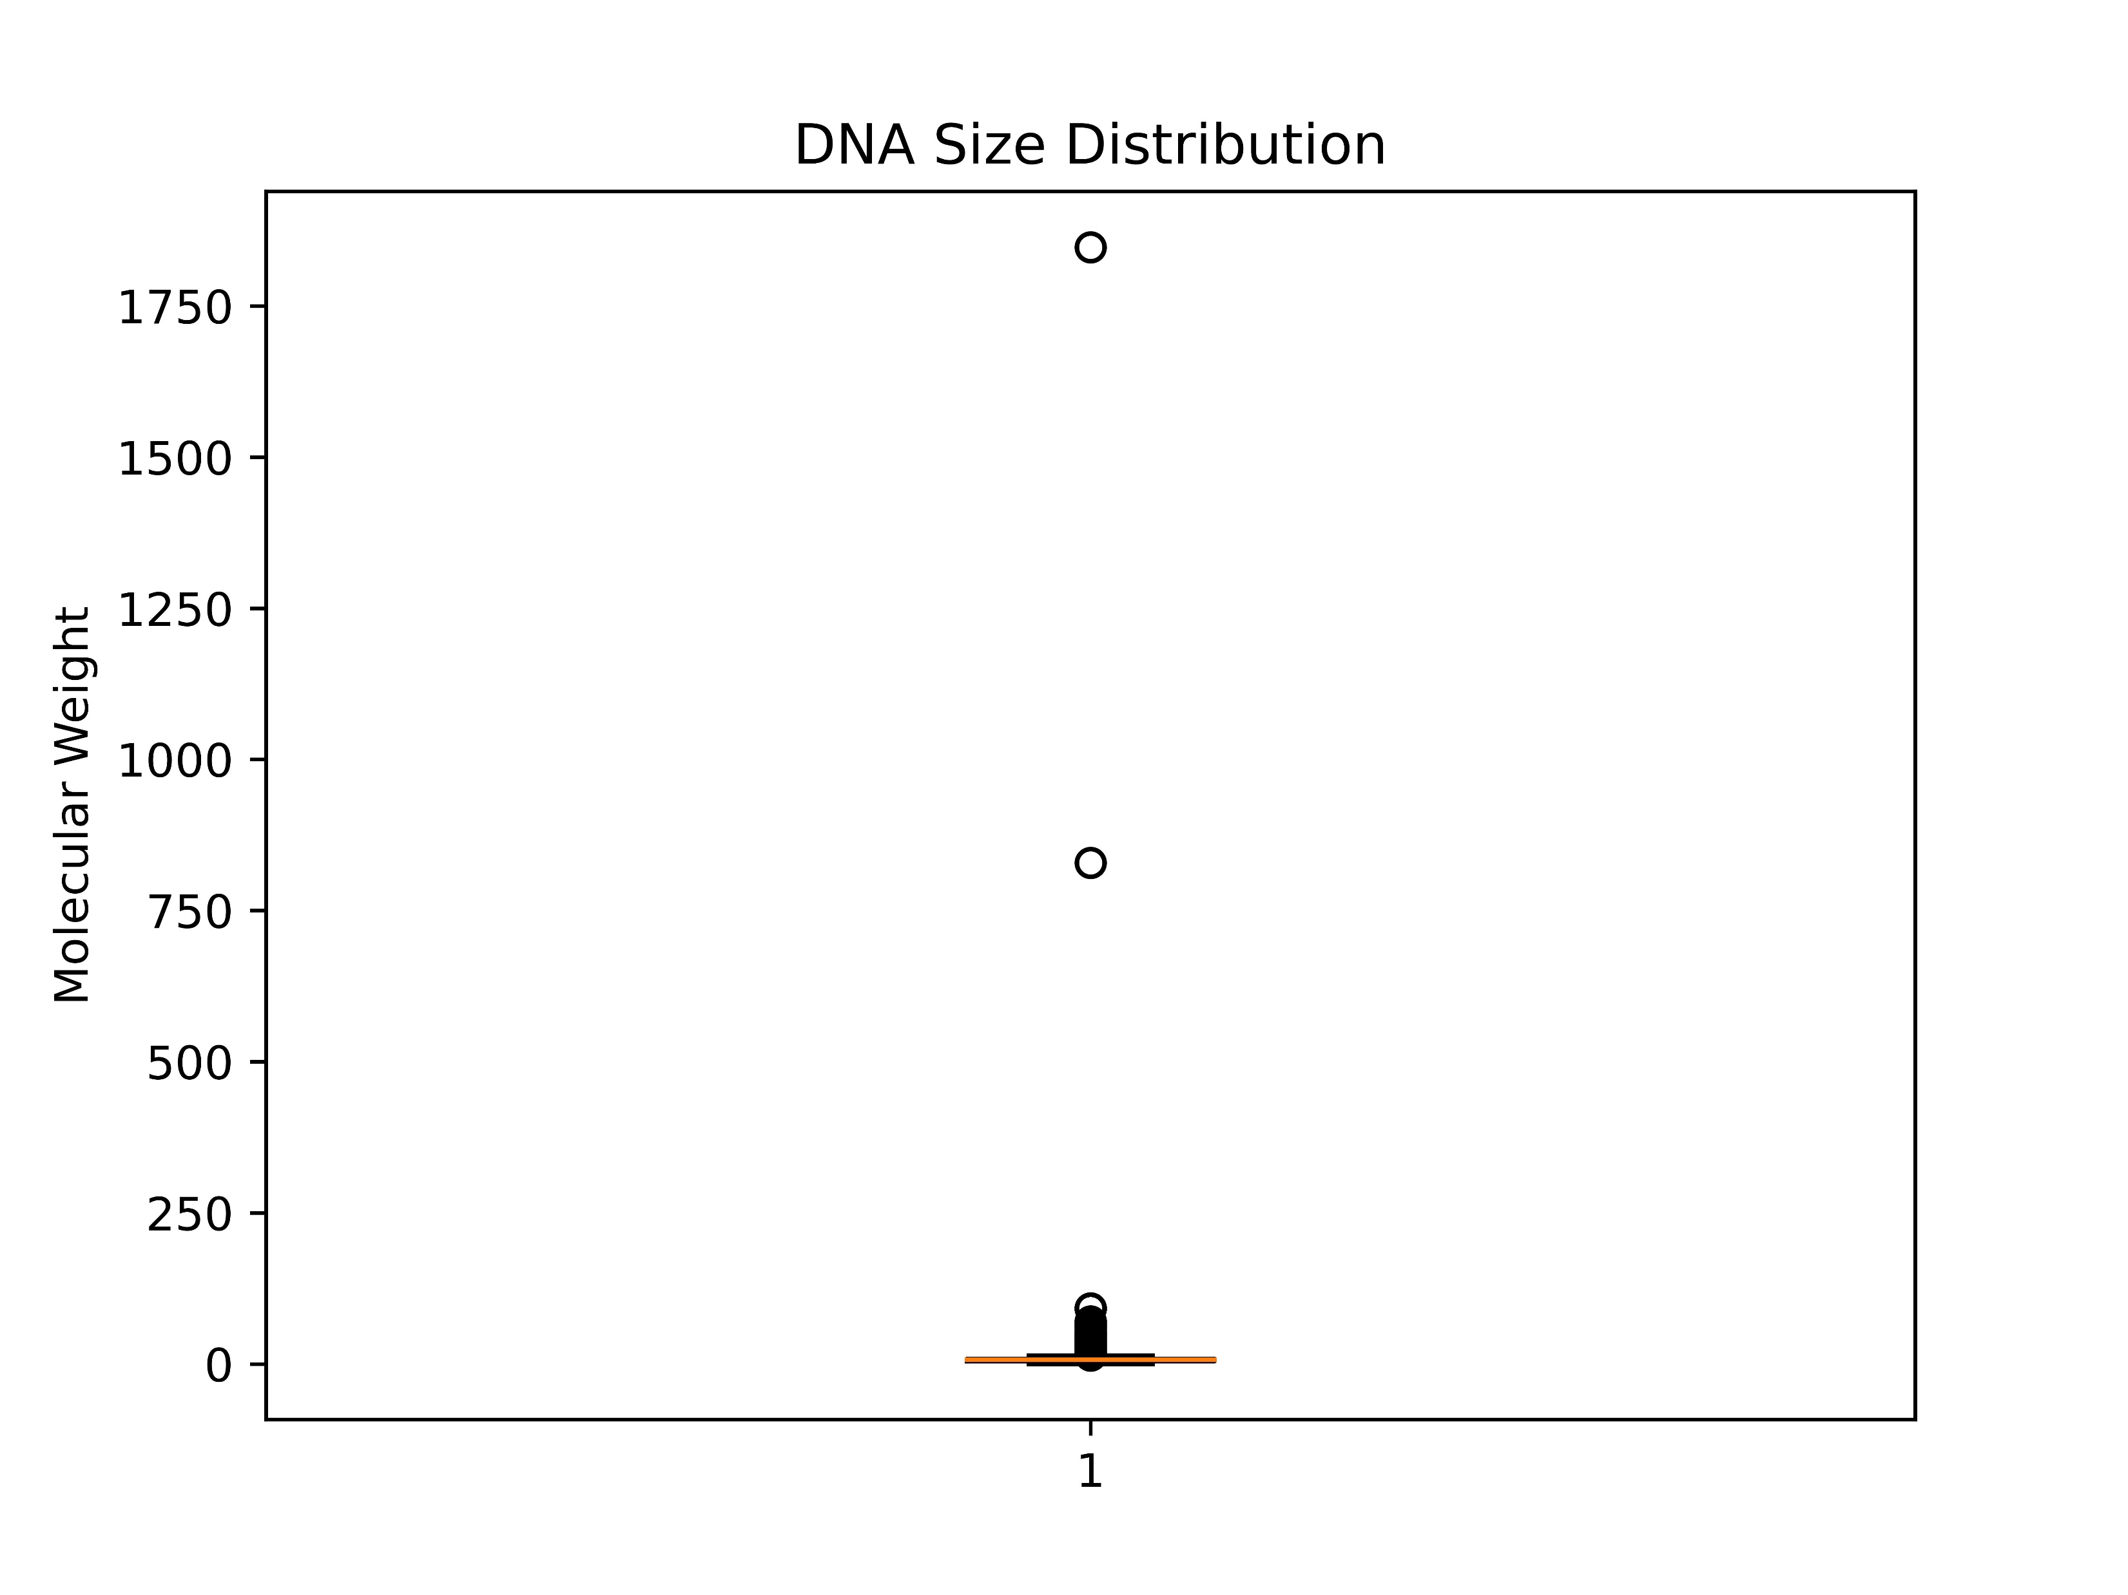
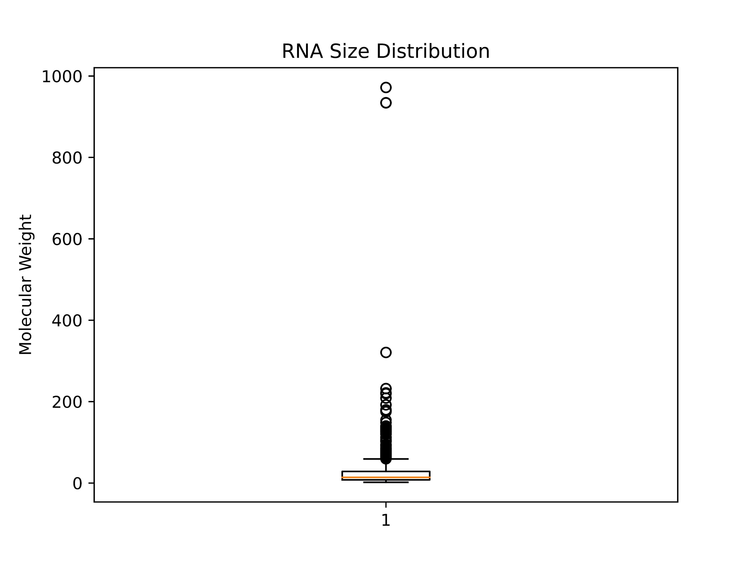
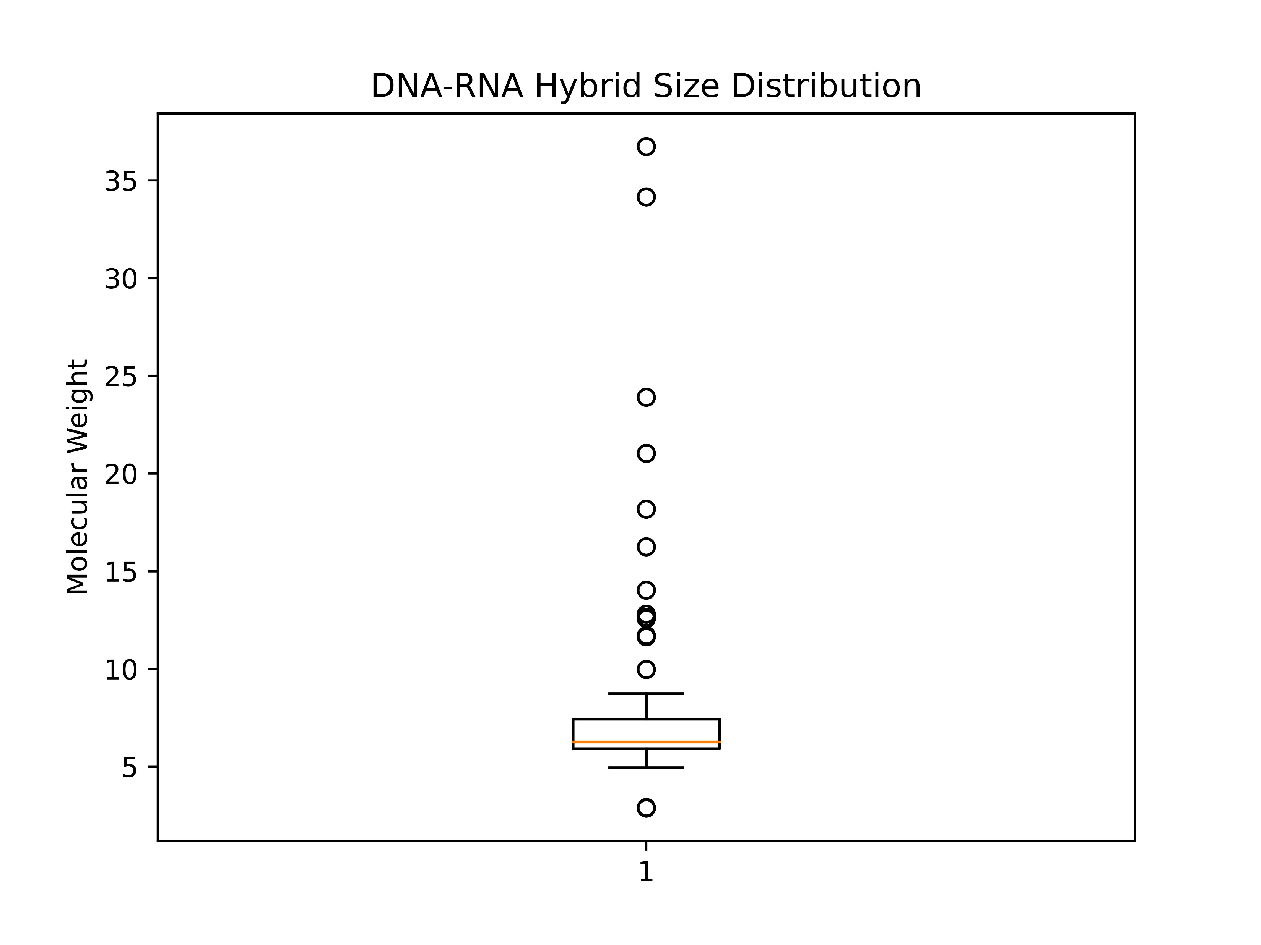
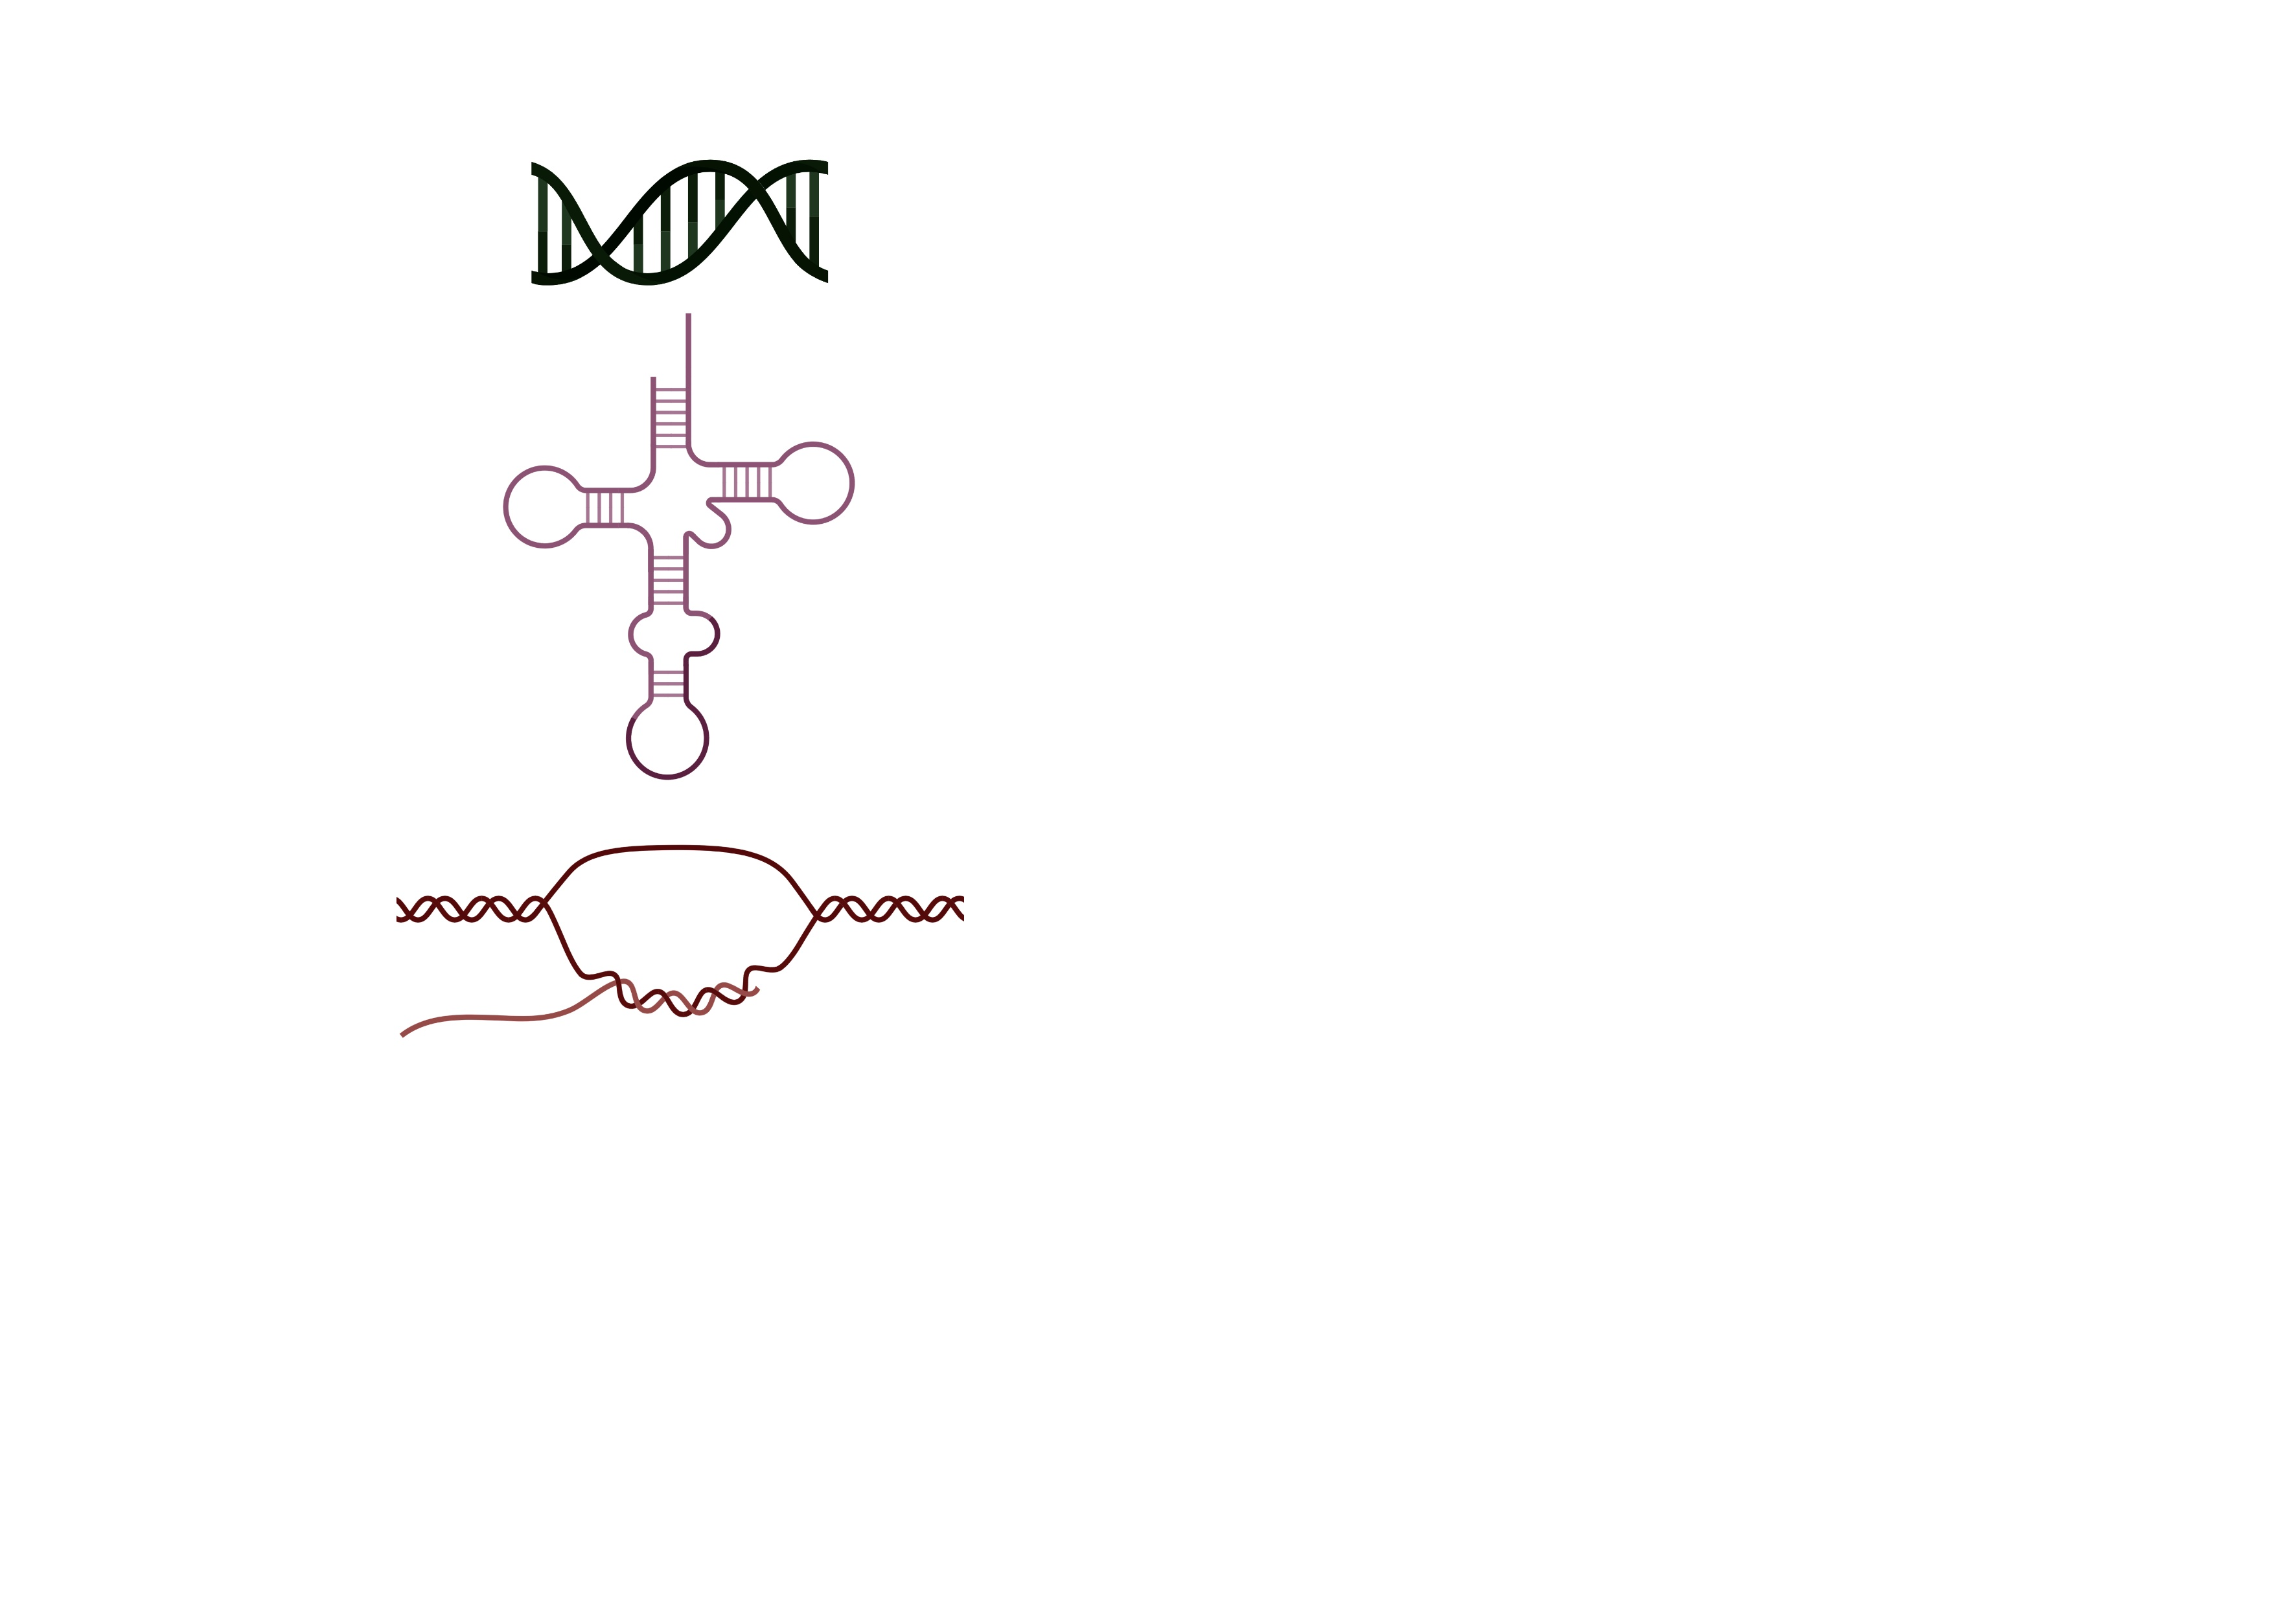
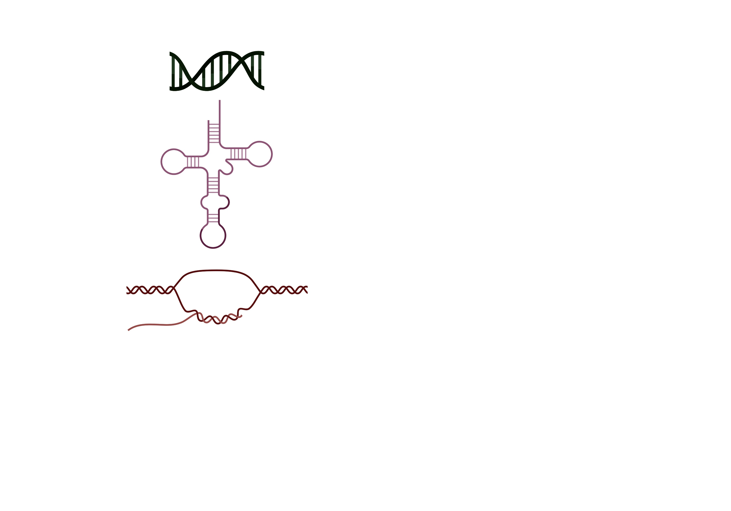
Part 1:Trends in the Size Distribution of Oligonucleotides
DNA and RNA sequences are similar in terms of their size.
Most of the sequences have a molecular weight of less than 200 kilodaltons (kDa).
The DNA-RNA hybrids are smaller in size overall.
Notes:
Move this first?

Slide 6
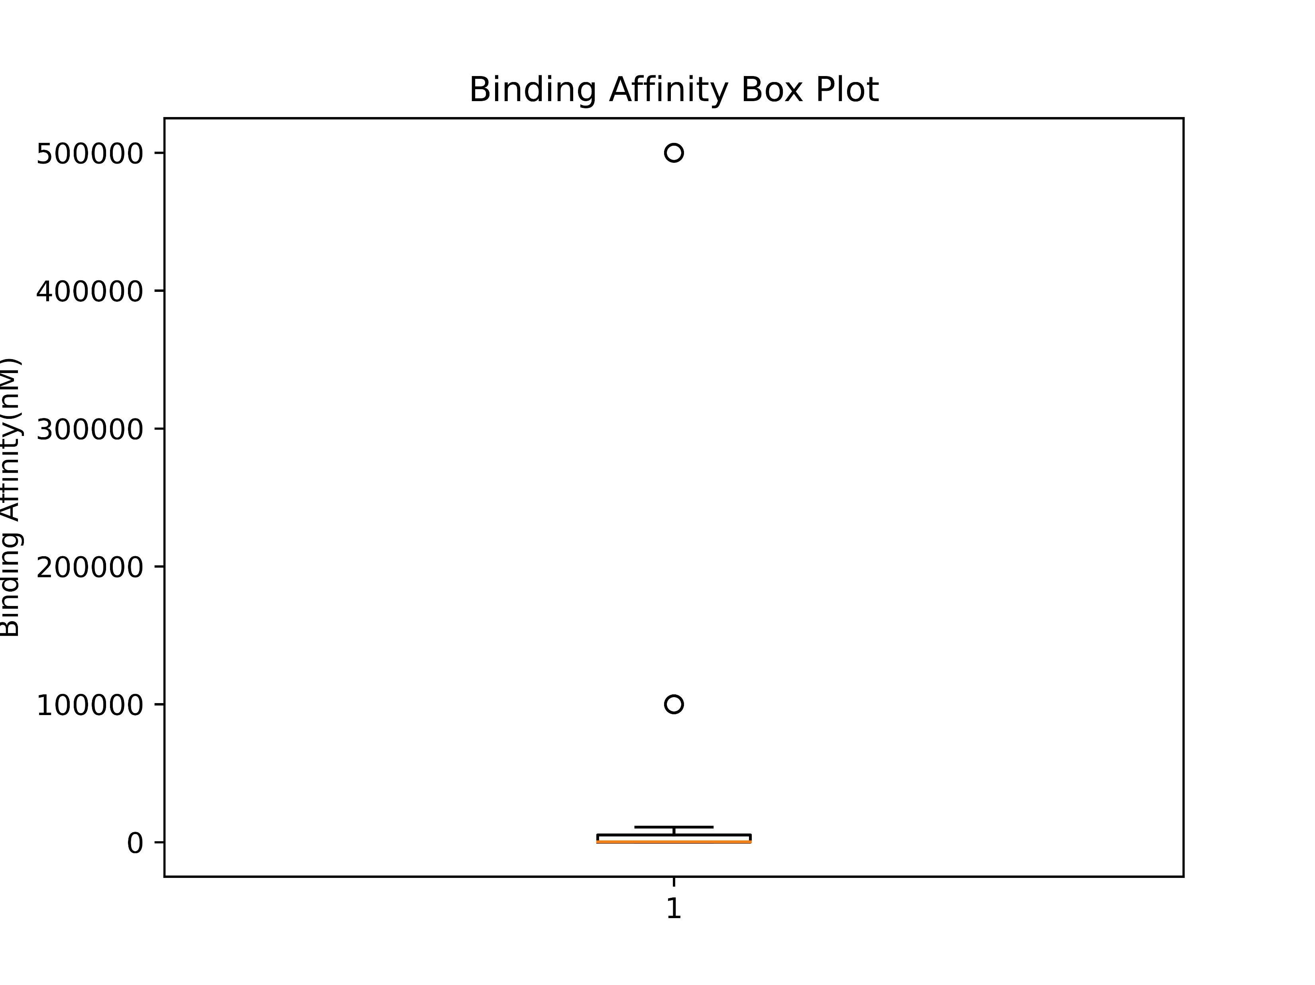
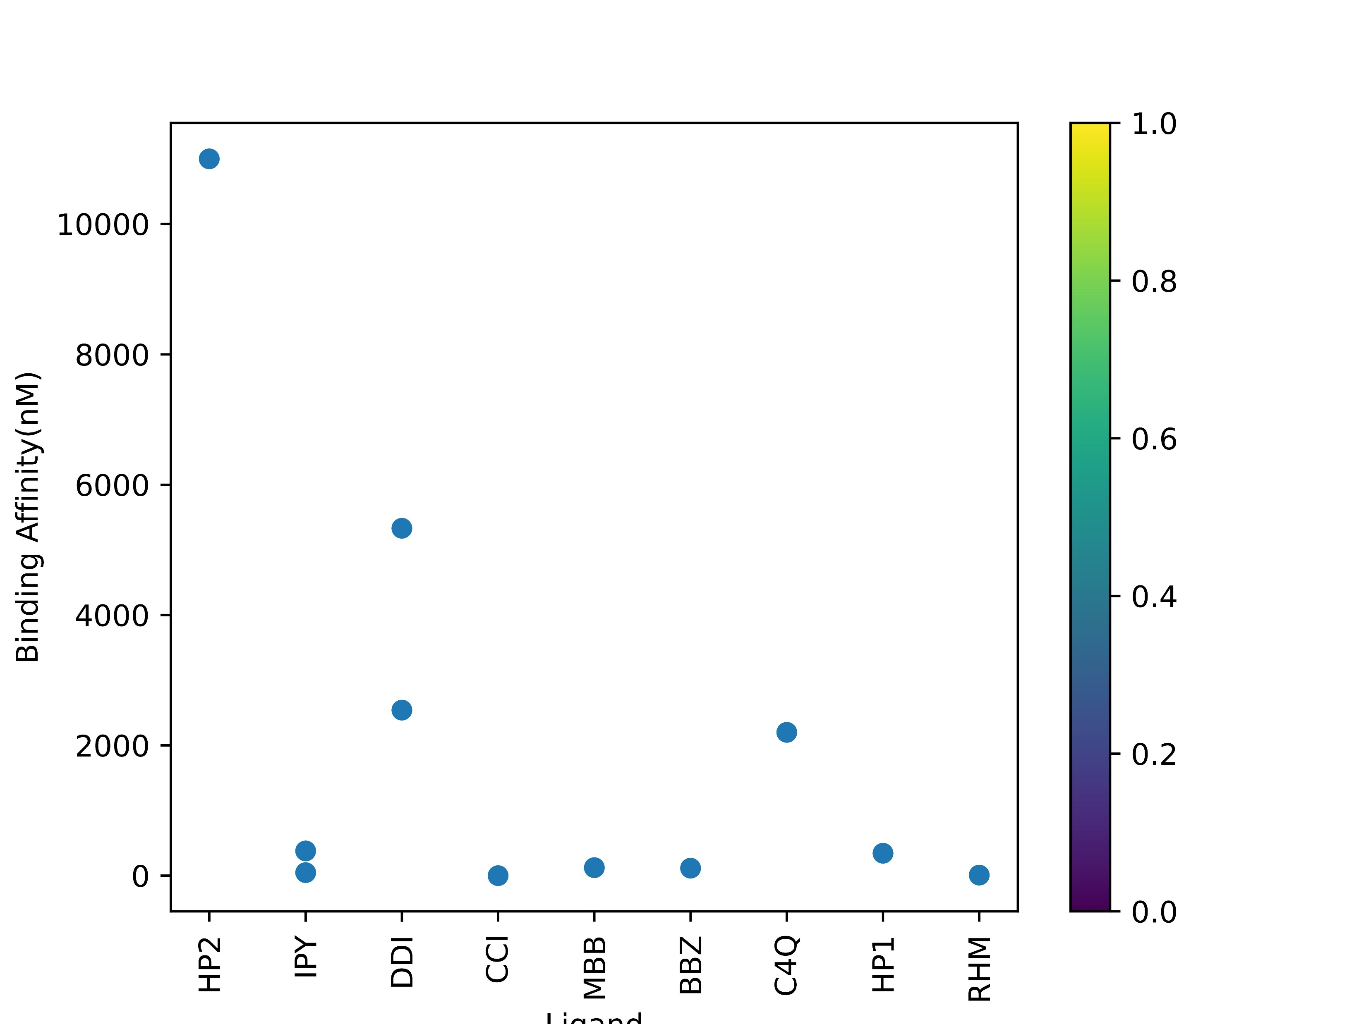
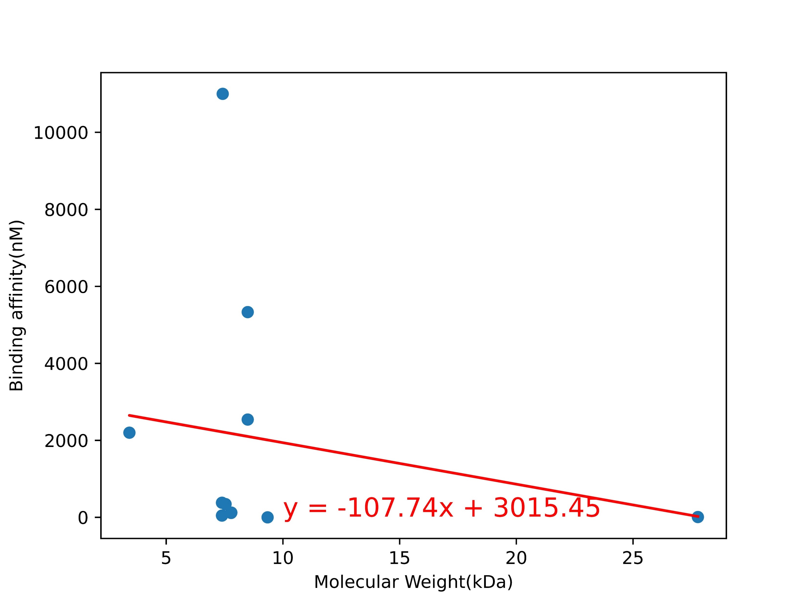
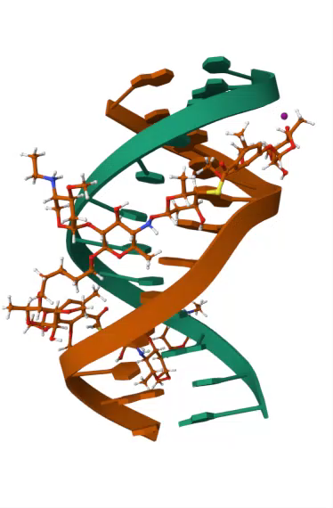
Part 2:Trends in the Binding Affinity of Oligonucleotides(DNA)
R² = 0.03940298452579422
Ligand
Most of the DNA sequences bind in a very tight range of binding affinity of sub 2000nM.
There is no correlation between the size of the DNA sequences and binding affinity.
Notes:
Move this first?

Slide 7
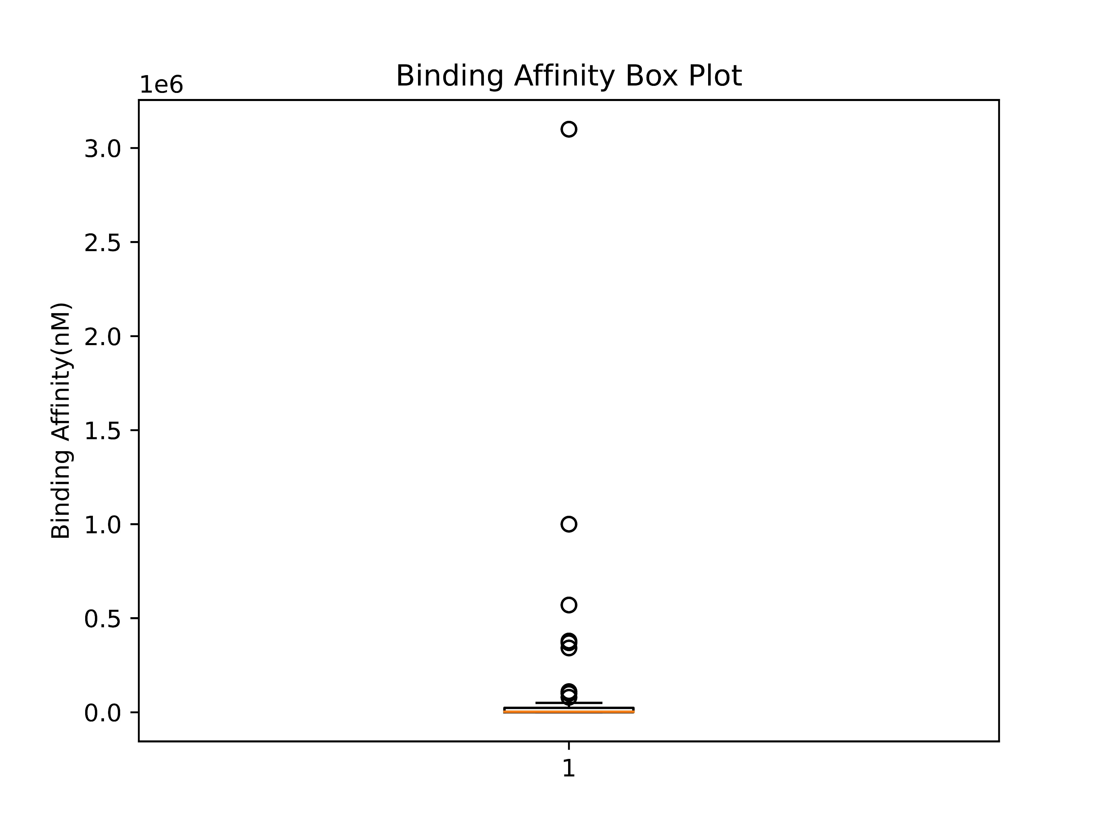
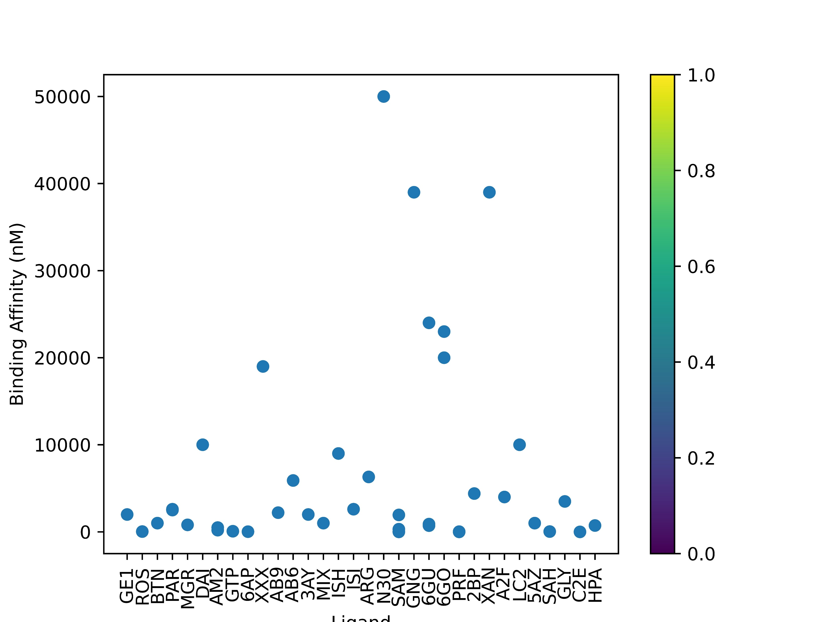
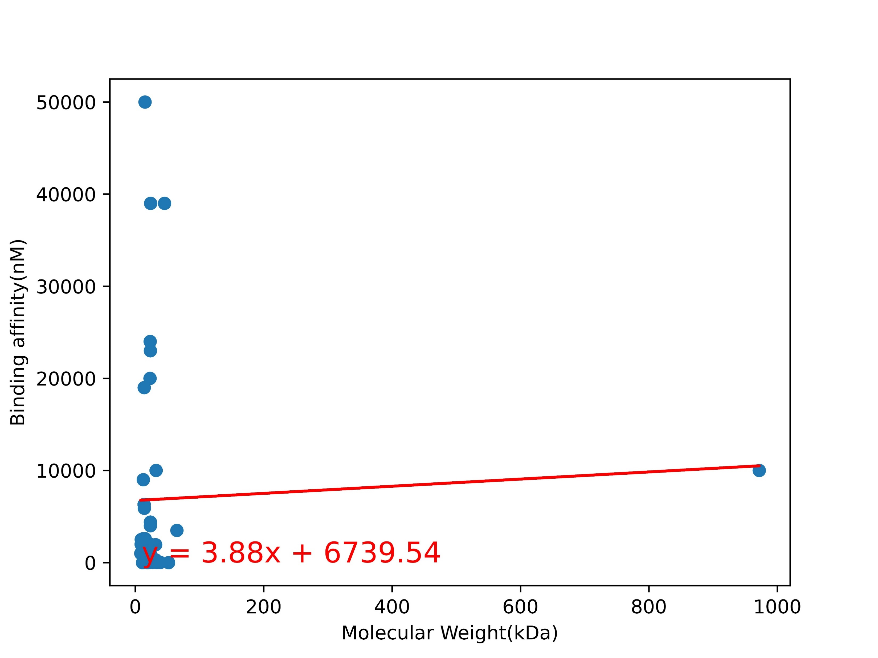
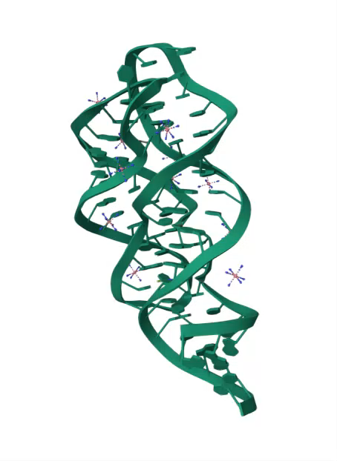
Part 2:Trends in the Binding Affinity of Oligonucleotides(RNA)
R² = 0.002277336600934839
Ligand
Most of the RNA sequences bind in a very tight range of binding affinity of sub 10000nM.
There is no correlation between the size of the RNA sequences and binding affinity.
Notes:
Move this first?

Slide 8
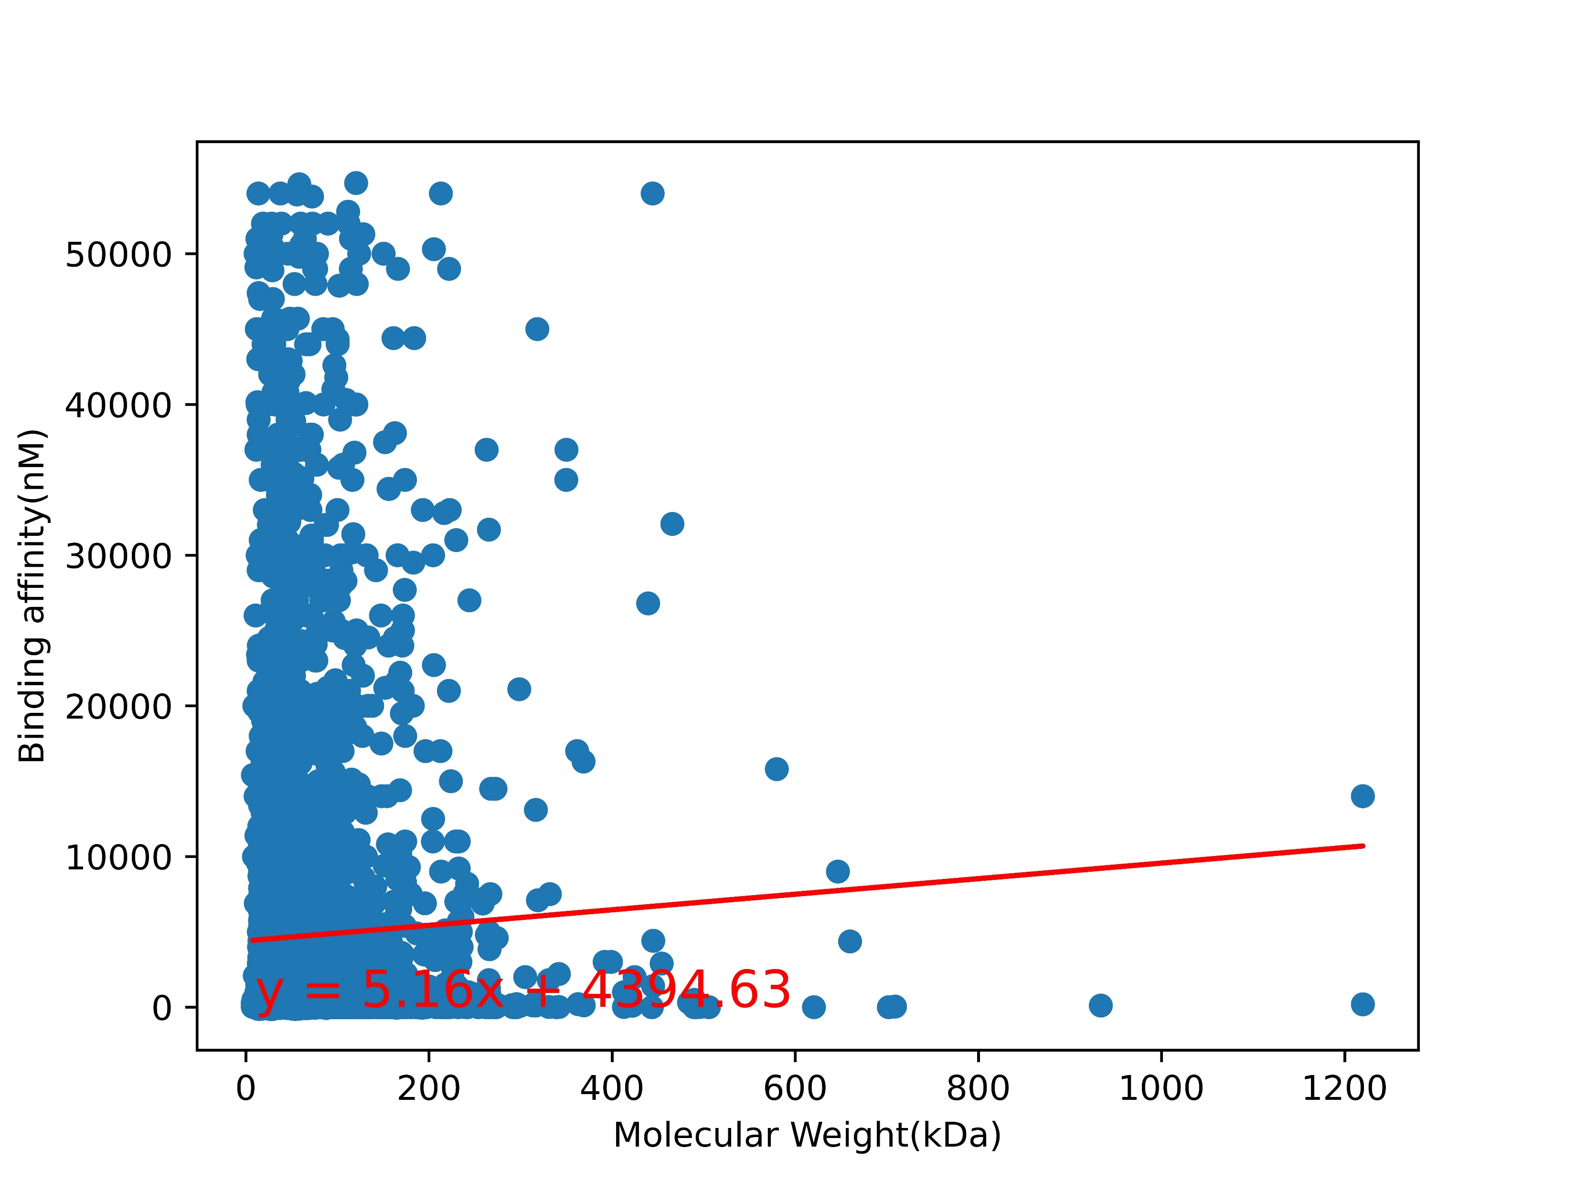
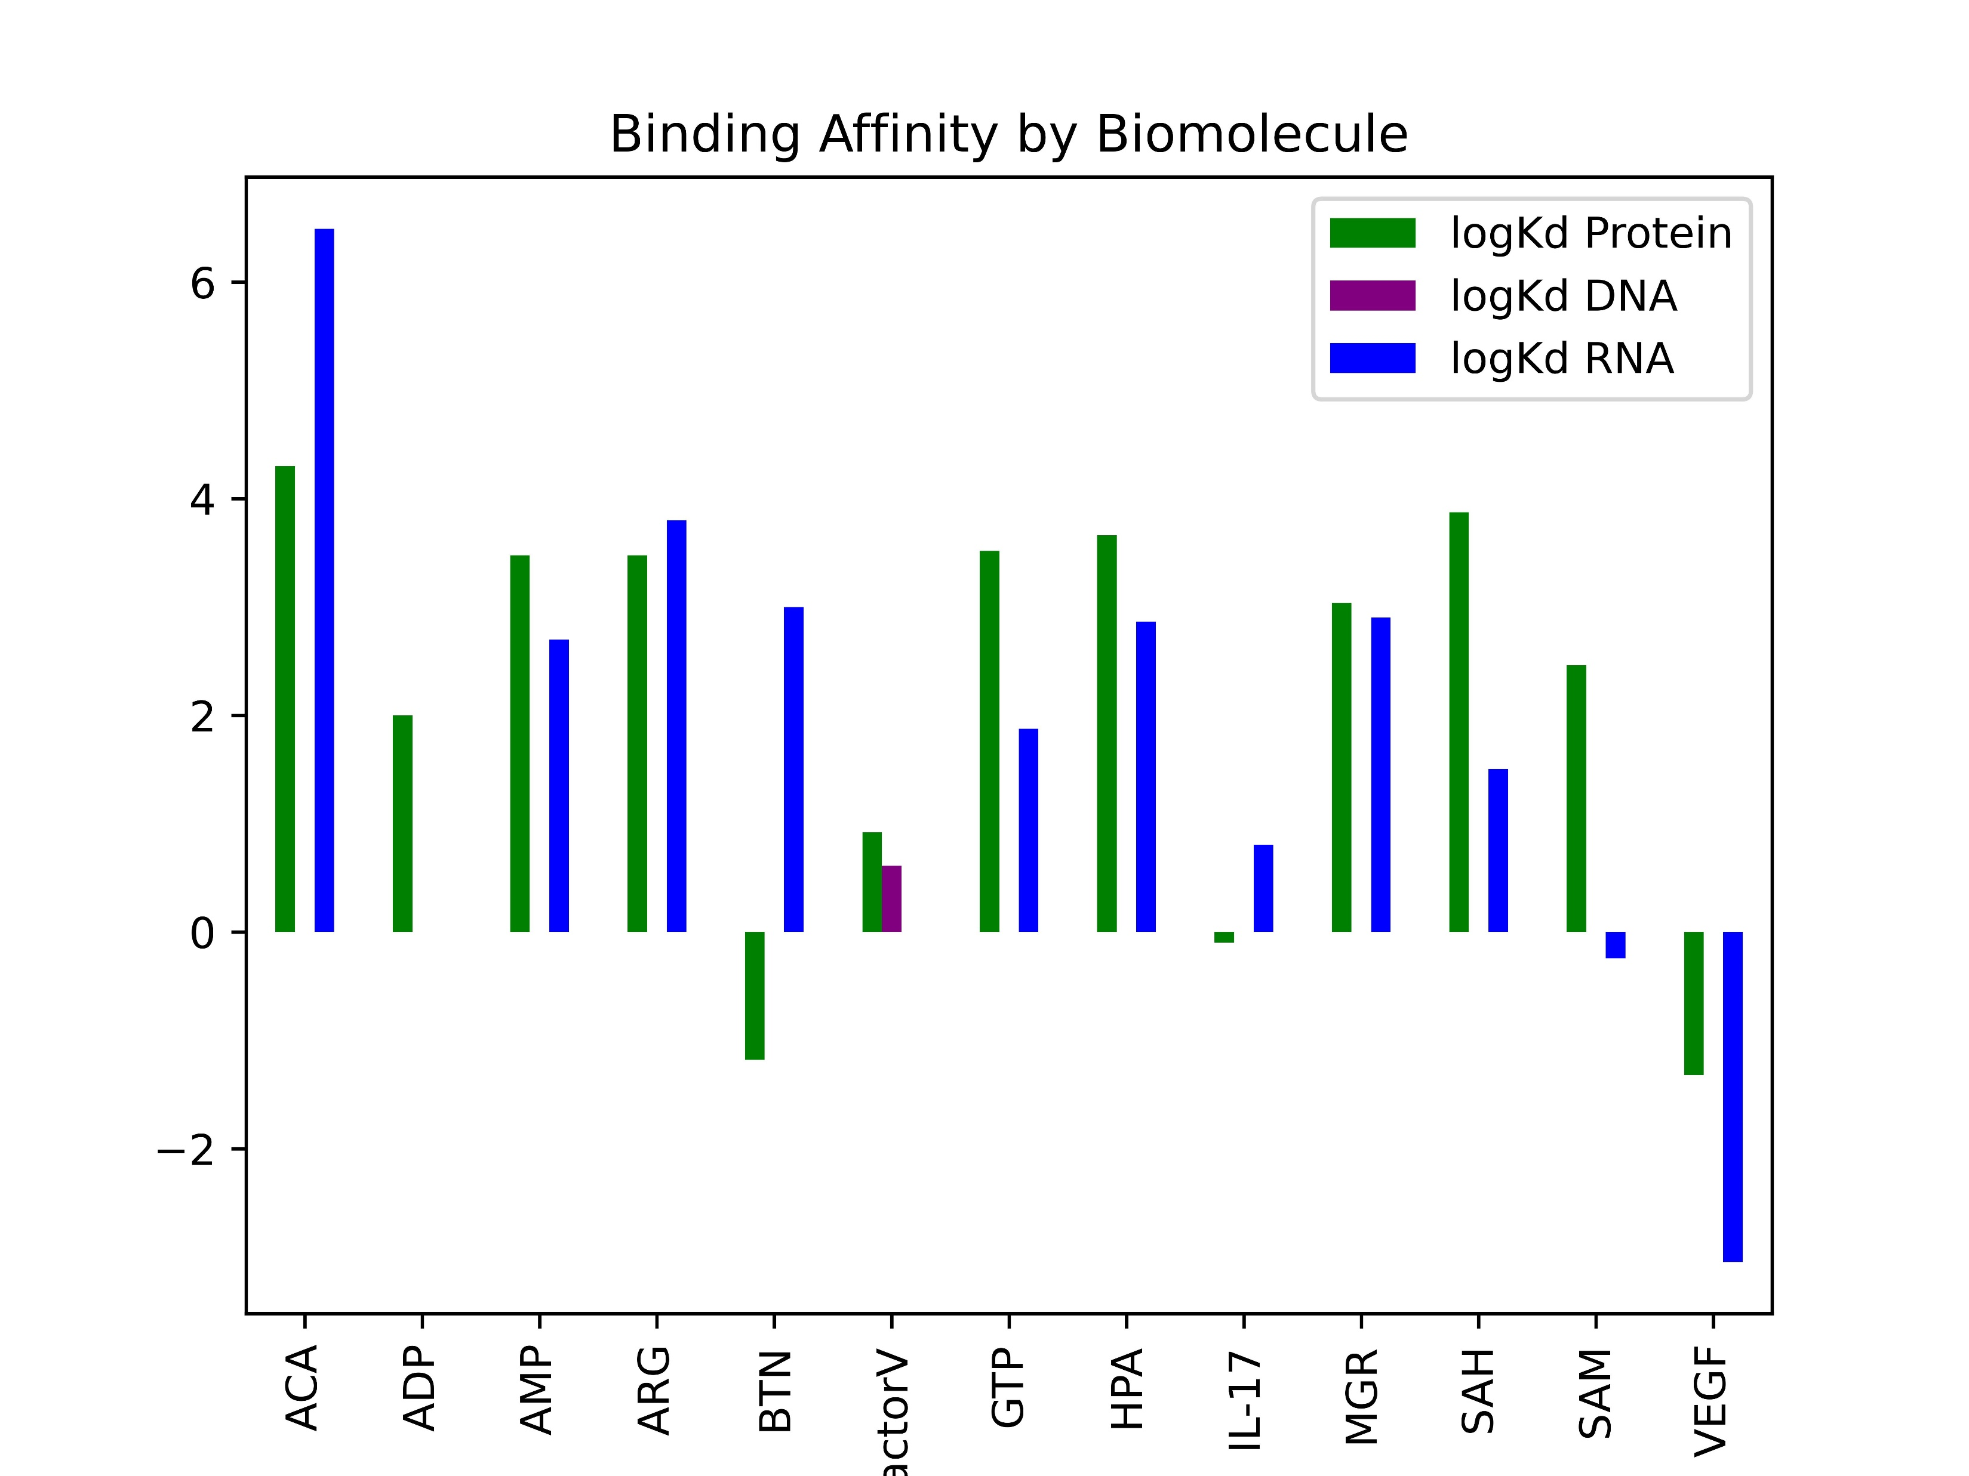
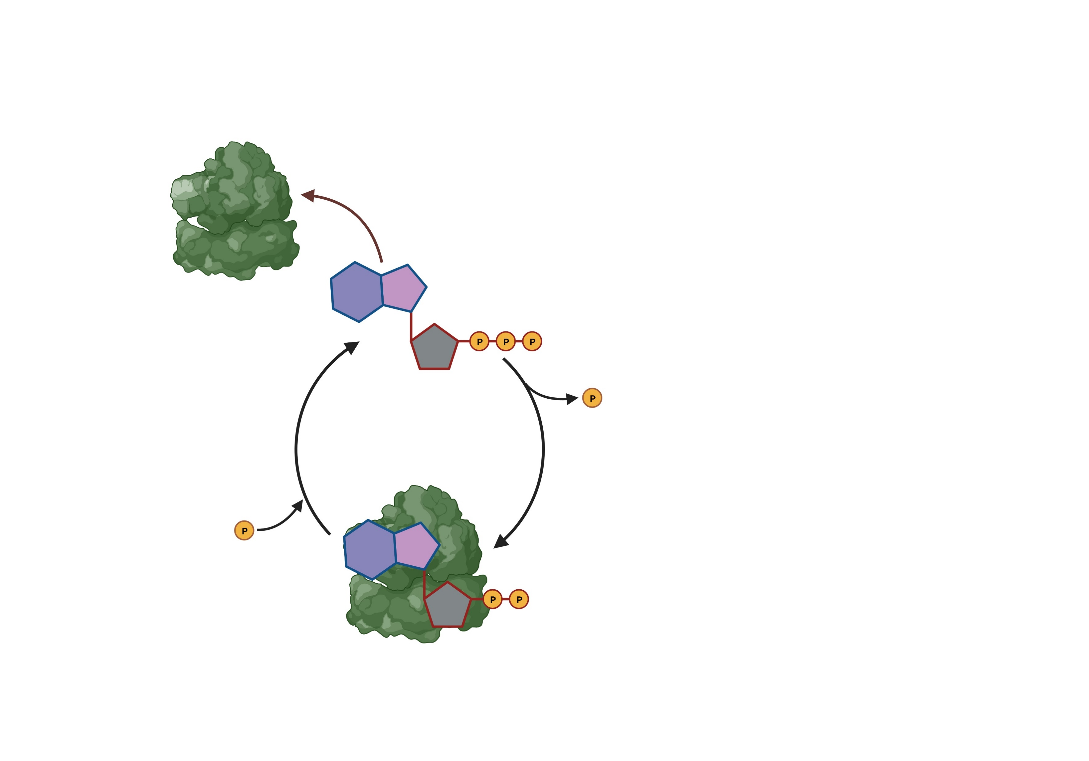
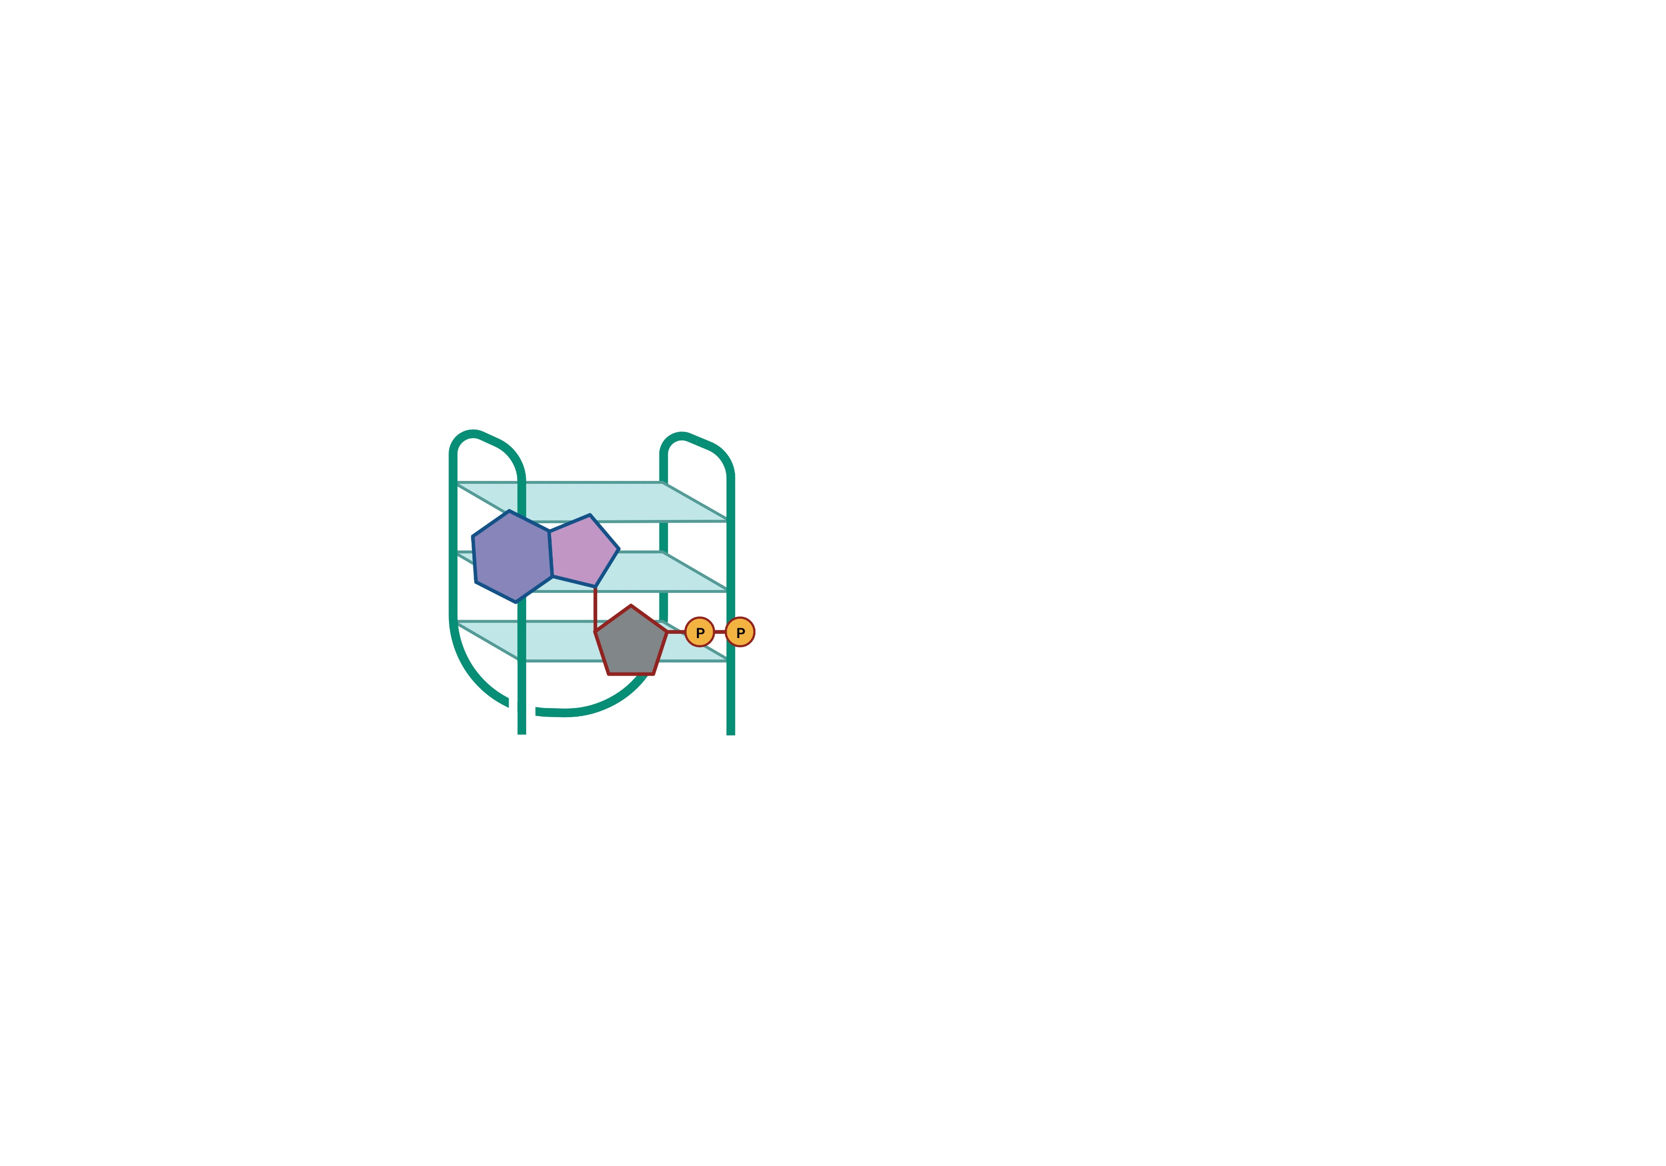
Part 3:Binding Affinity of Proteins vs Oligonucleotides for Same Target
R² = 0.0013906855693701556
Enzyme
Vs
There is no correlation between protein size and binding affinity
For the same ligand, DNA, and RNA are better binders overall.
However, the picture is more complicated than that.
Perhaps a ligand-by-ligand analysis is warranted.
RNA
Binder
Notes:
Move this first?

